Slide 1

Welcome to Basic Web Development using HTML, CSS and JavaScript
By: Maynard I. Capil

Slide 2
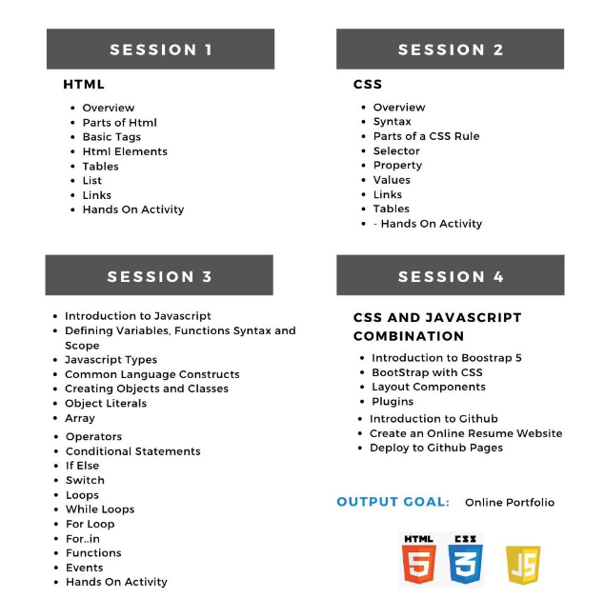

Slide 3


Maynard Capil, MIT, MCSA
Doctor in Information Technology – in-progress
Masters in Information Technology
Profession: SQL Server DBA / 13+ years in
I.T Industry
Bachelor of Science in Information Technology
Vocation: 3+ years as part time I.T Lecturer
Specializations:
Database Administration, Windows Server, Backend Automation, Project Management,
I.T Operations and Management, .NET Programming
Associate Degree in Software Development
Subjects Taught:
Information Management
Database Administration
Object Oriented Programming
Introduction to Programming
Software Engineering
I.T Project Management
Web Development
Technical Certifications
Microsoft Certified: Azure Database Administrator Associate
Microsoft Certified: Azure Data Engineer Associate
Microsoft Certified: Azure Administrator Associate
Microsoft Certified Solution Associate MCSA: SQL 2016 Database Administration
Scrum Foundation Professional Certificate
Cyber Security Foundation Professional Certificate - CSFPC™
Remote Work and Virtual Collaboration Professional Certificate - RWVCPC

Slide 4

Why Software Development is Important?

Slide 5
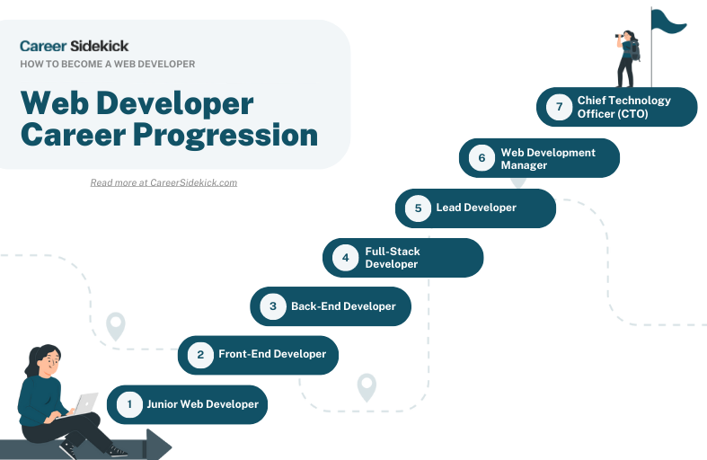
Career Path

Slide 6
Skills Roadmap
https://roadmap.sh/

Slide 7
Web Application Concepts

Slide 8
Steps to becoming a Web Developer
Learn the fundamentals
Study independently
Build projects / portfolio
Begin applying for position
REPEAT

